Slide 1
iCLM HQ 885/TPT-SUPPLY OF MATERIAL AND THE CONSTRUCTION OF STORM WATER & ENVIRONMNETAL SYSTEMS AT SALDANHA TERMINAL AT THE TRANSNET PORT TERMINALS (TPT), BULK TERMINAL SALDANHA (BTS).
Specific goals--Enterprise & Supplier Development & Localisation
Presented By: Lungelo Manci
Notes:
Growth and Reinvent

Slide 2
Transformational Specific Goals as per Transnet Preferential Procurement Policy (TPPP)
Priority will be given to the specific goals to advance areas or categories of persons or groups who were previously disadvantaged. Preferential Procurement point system will be allocated as per the table below:
Preference Point System 90/10
Specific Goal | Number of Points | Price
B-BBEE Level 1 & 2 | 5
30% Sub-Contracting to: BO EMEs &QSE (51% BO) | 5
Total | 10 | 90
Specific Goal | Acceptable Evidence
B-BBEE Level 1 & 2 | B-BBEE Certificate/Sworn-Affidavit/ CIPC B-BBEE Certificate JV consolidated scorecard and JV agreement.
30% Sub-Contracting | Sub-contracting agreements; • Subcontractors CIPC – B-BBEE Certificate / Sworn- Affidavit / B-BBEE Certificate as per DTIC guideline

Slide 3
VALID SWORN AFFIDAVIT
Valid B-BBEE Certificate issued by SANAS accredited verification agency or Sworn affidavit.
Valid Sworn affidavit must have the following:
Name of the deponent,
ID number,
Designation (Owner, Member or Director),
Name of the Entity, (Trading name, registration number and tax number)
Percentage of black ownership with designated groups,
Indicate financial year and revenue (DD/MM/YYYY)
B-BBEE level.
Date deponent signed and date of Commissioner of Oath must be the same.
Commissioner of Oath cannot be an employee or ex official of the enterprise because, a person cannot by law, commission a sworn-affidavit in which they have an interest

Slide 4
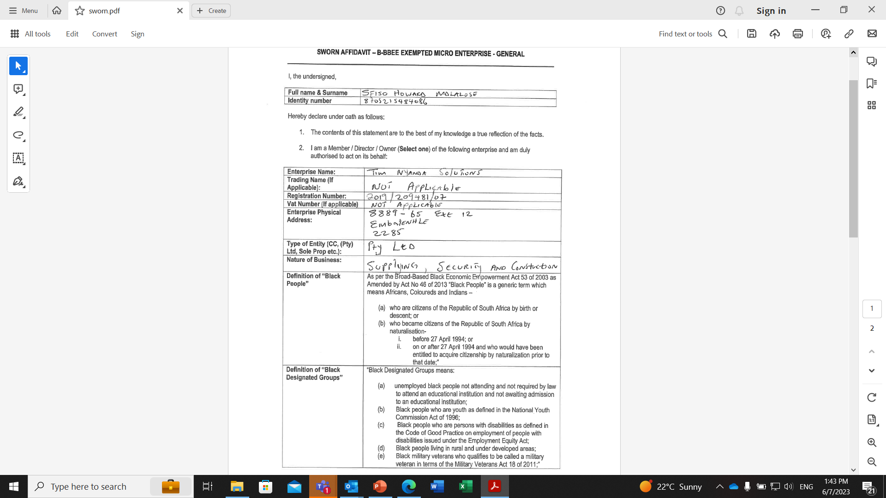
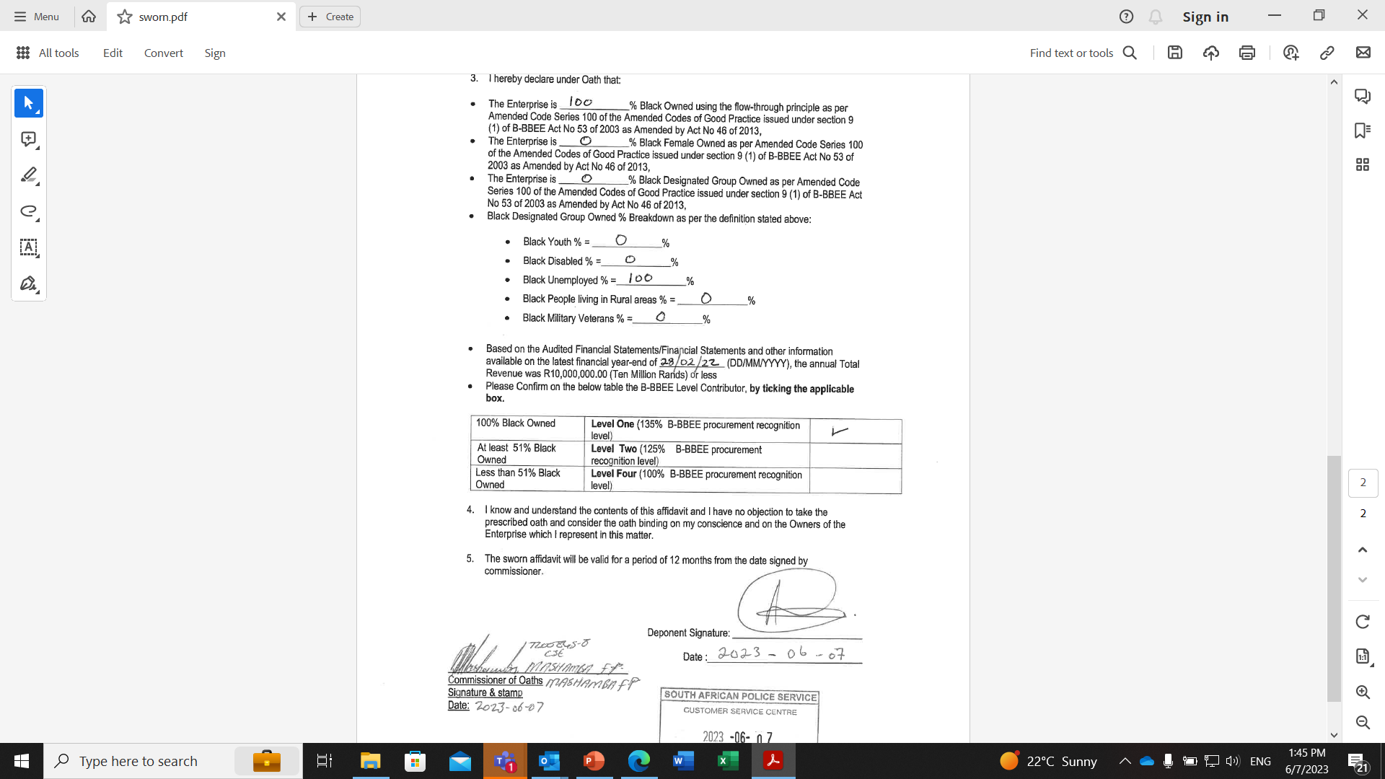
VALID SWORN AFFIDAVIT

Slide 5
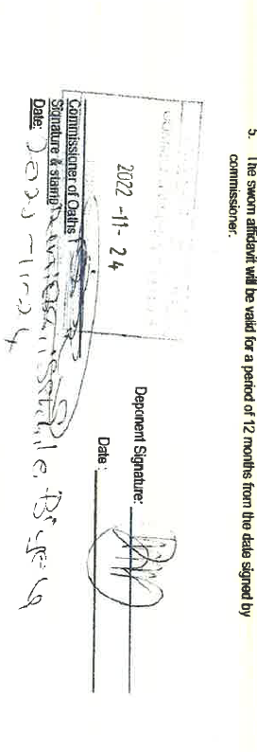
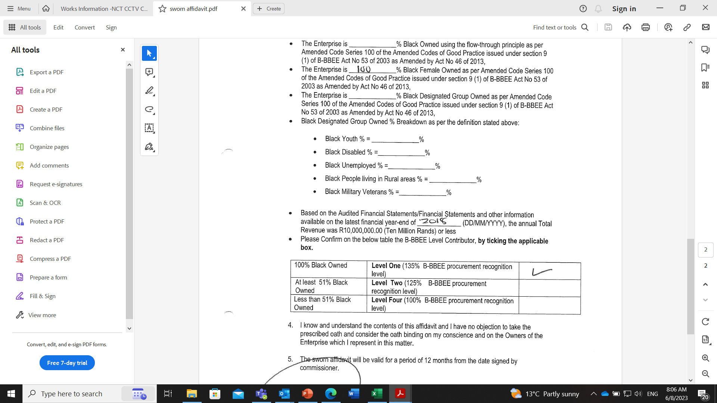
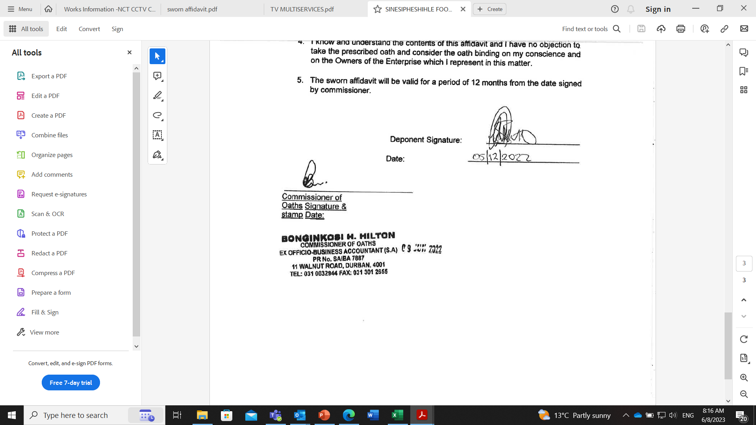
COMMON MISTAKES
  Omitting full name and surname and identity number of the deponent (undersigned-person declaring under oaths).
  Dates of the deponent and commissioner of oaths are not the same
  Date for either commissioner of oaths or deponent is omitted.
  Not completing company financial year information i.e. DD/MM/YYY
  Not ticking the applicable box on the B-BBEE level contributor
  No stamp of the commissioner of oaths on the B-BBEE sworn affidavit.
  If commissioner of oaths stamp does not have date, it must be written manually and should be the same as for the deponent.
  B-BBEE sworn affidavit must be completed in the presence of the commissioner of oaths.
  It is the responsibility of the deponent not commissioner of oaths to ensure that B-BBEE sworn affidavit is completed in full.

Slide 6
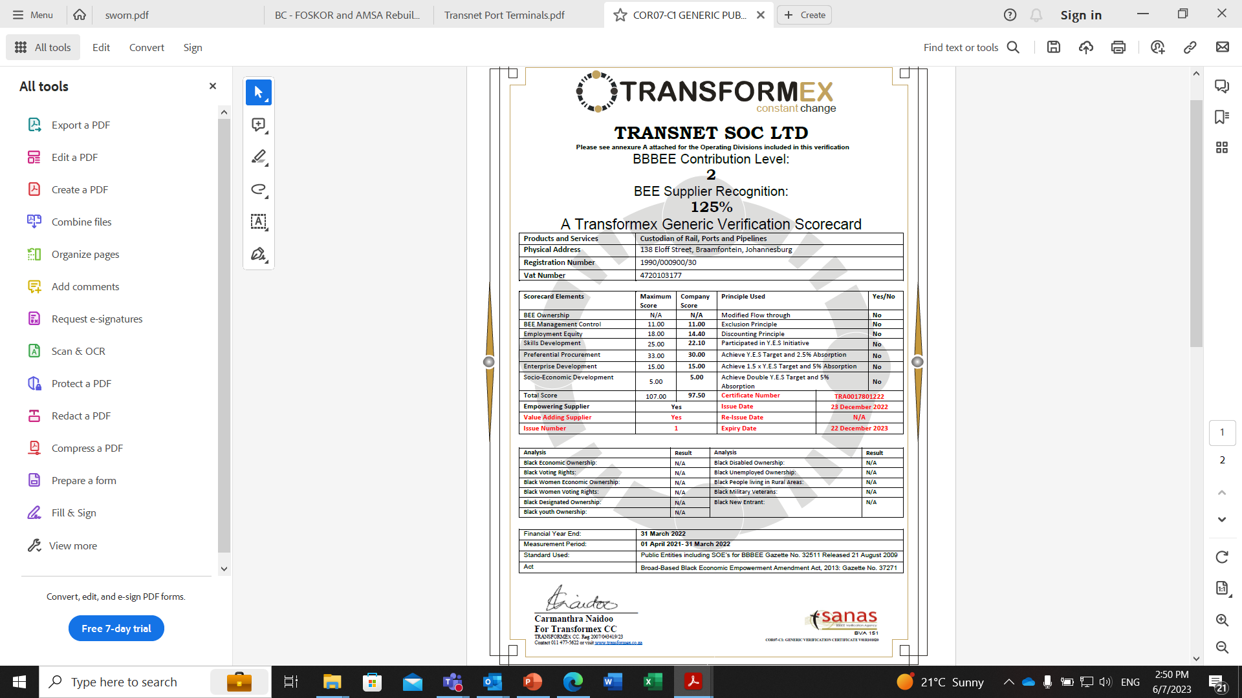
VALID B-BBEE CERTIFICATE
Notes:
Certificate must be done by a SANAS accredited verification agency. This is checked on the SANAS website to confirm the Verification Agency

Slide 7
Joint Venture
In 2019 DTI released amendments to the Codes of Good Practice. Joint Ventures are referred to in Revised Code 000, Statement 000: General Principles
- As per paragraph 7 of Amended Code Series 000, Statement 000 of the Codes of Good Practice, unincorporated joint ventures are required to compile a consolidated verification certificate. A consolidated verification certificate will consolidate the verified compliance data of joint venture partners if those Measured Entities were a single Measured Entity.
- A JV will require its own Broad-Based Black Economic Empowerment (B-BBEE) certificate if they would like to tender or enter a contract that requires a B-BBEE Certificate.
- A trust, consortium or joint venture (including unincorporated consortia and joint ventures) must submit a consolidated B-BBEE Status Level verification certificate for every separate bid.
- Note the following:
• A consolidated verification certificate is required.
• The consolidation is based on the weighting as defined in the joint venture agreement.
• The respective scores are weighted according to their proportionate share in the joint venture.
• A joint venture certificate is valid for 12 months and only applicable to a specific project.
Eligibility of a Joint Venture
Joint Ventures are required to compile a consolidated verification certificate. A consolidated verification certificate will consolidate the verified compliance data of joint venture partners in accordance .

Slide 8
Thank you

